Slide 1
PYRAMINX…..The Untold Story..
Karan Chadha - 140070014
Kalpesh Krishna - 140070017
Roshan Nayak - 140040097
Harita Parmar - 140110014

Slide 2
Problem Statements
To detect colors of stickers of pyraminx using image processing and send this data to computer .
Android app, camera integration, colour thresholding using HSV, Blob Detection, Matching blobs with Equilateral triangles, Socket “Async” Programming, File Handling

Slide 3
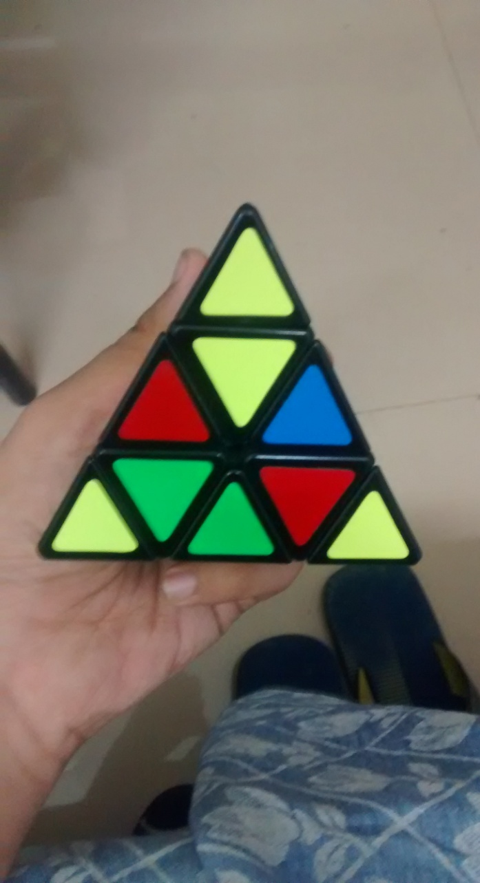
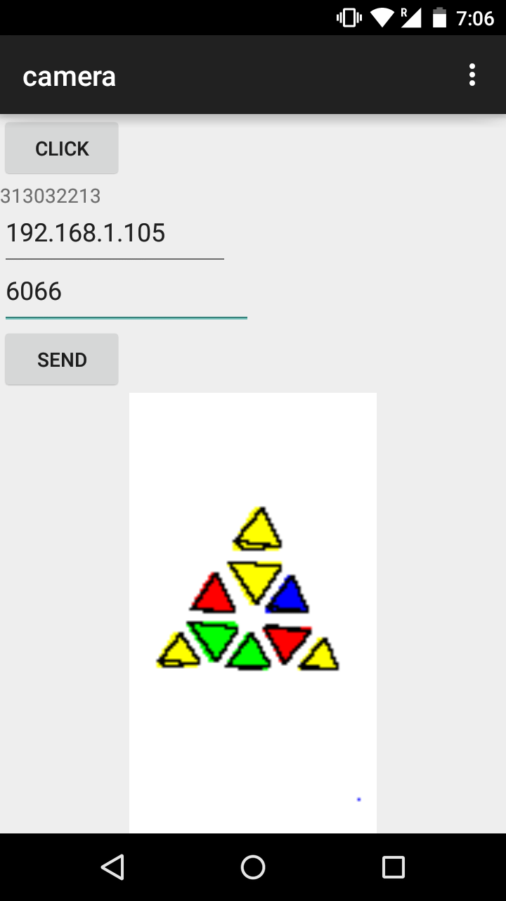
Android app and Image processing

Slide 4
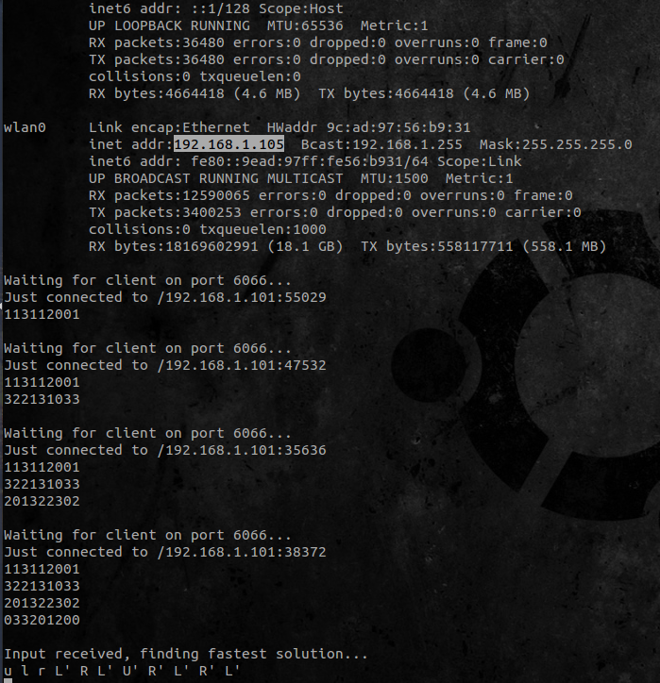
Mode-1 IP Receiver

Slide 5
Problem Statements
To find fastest solution to that pyraminx.
Breadth First Search, initially with simple arrays, later with Binary Search Trees implementing AVL logic, converting BFS solution to cube notation, display solution using Allegro and coordinate geometry

Slide 6
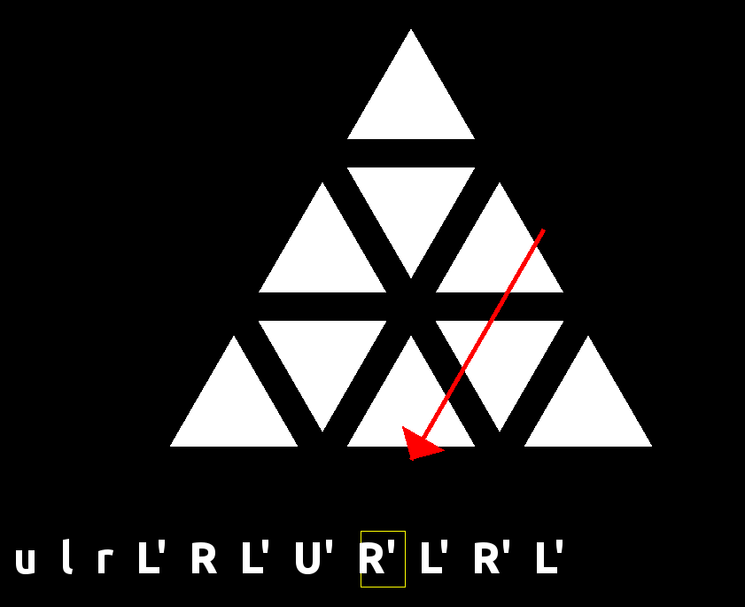
Solution Display

Slide 7
Problem Statements
To generate scrambling algorithms and implement GUI to solve the pyraminx.
Random seeds to generate random cube notation shuffle, Allegro, file handling and coordinate geometry to display shuffled cube.

Slide 8
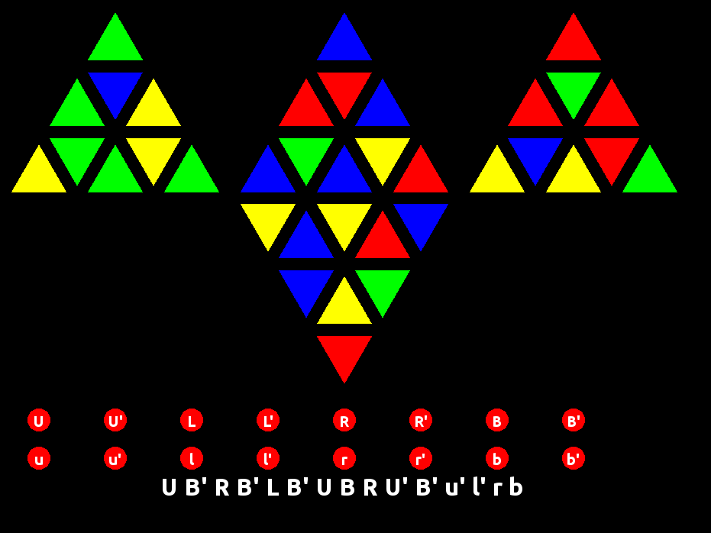
Pyraminx Shuffler GUI

Slide 9
Problem Statements
To provide analysis on the user solve.
File Handling to receive shuffling algorithm and user’s move attempt, using above BFS code within a for loop to find analysis after every move done by user

Slide 10
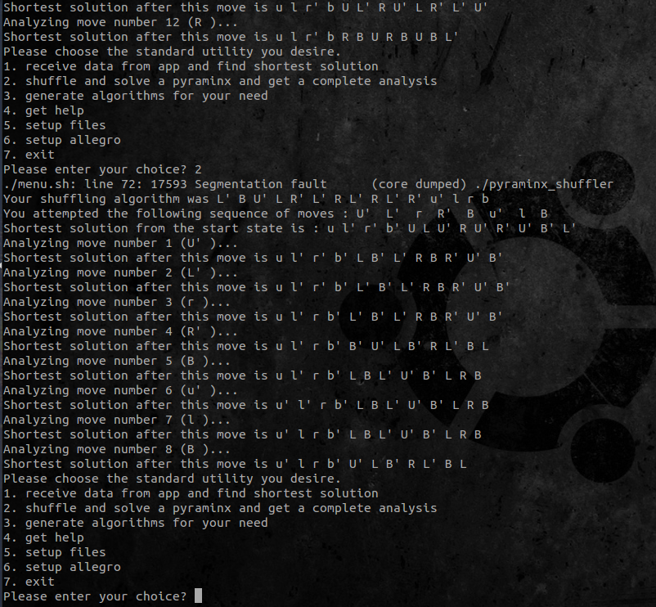
Mode-2 Analysis

Slide 11
Problem Statements
To generate cubing algorithms for tasks on pyraminx. And to implement the GUI for the same.
Allegro interface allowing user to provide sticker colour input, BFS code used with modifications to find algorithm, solution displayed using Allegro

Slide 12
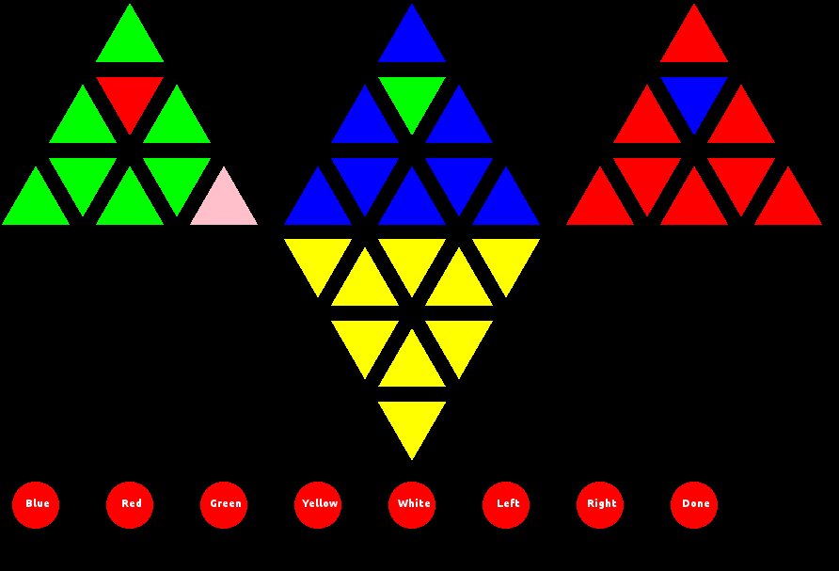
Algorithm finder GUI

Slide 13
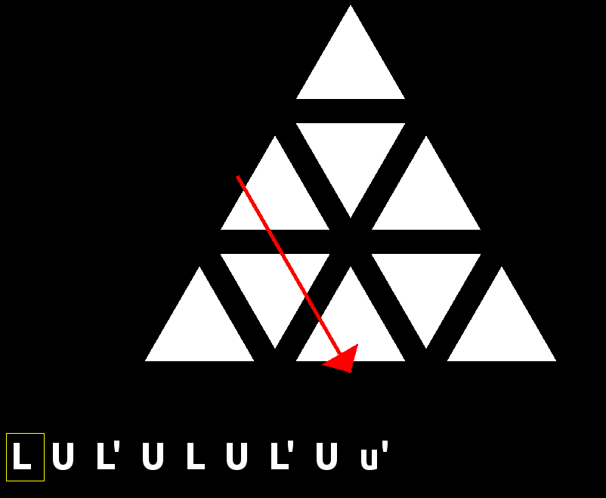
Mode-3 Algorithm Display

Slide 14
Extra Work Done
Files to make menu, compile all programs, setup allegro without hassle
Implemented using three Bash Scripts.

Slide 15
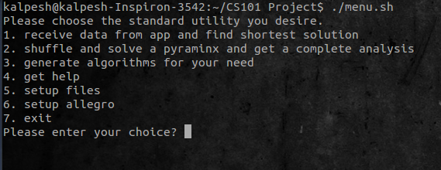
Menu script

Slide 16
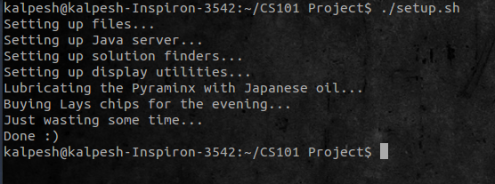
Setup Script

Slide 17
Challenge
The time taken for BFS algorithm was more than a day , this was rectified by changing data structure used . We changed simple array based implementation to the Binary search tree implementation and used AVL to balanced the trees. This reduced many steps from O(n) to O(log n) and time reduced to 15 seconds in worst case scenario and 4 seconds on an average.

Slide 18
Challenge
Blob detection was initially implemented using a recursive strategy. This was causing a stack overflow error. We changed the strategy to a iterative based “frontier” building approach.
Colour thresholding wasn’t working very well. This was improved by changing the RGB system to HSV.

Slide 19
Future work
We can improve algorithm finder by adding links between stickers .
Implement 3-D pyraminx .
Change menu bar from a bash script to a GUI .
Improve interface for Android app.
Convert setup.sh to make file
Transfer entire project to an android app or a web application for portability. Could be a useful app for speedcubers.

